Slide 1

Introduction to IAM

Slide 2
Overview
What is Cloud Computing?
Advantages of Cloud Computing
What is AWS?
IAM: Users & Groups
IAM Permissions
IAM Policies Structure
IAM Roles for Services
IAM Security Tools
IAM Guidelines & Best Practices

Slide 3
Cloud Computing
Cloud computing is the on-demand delivery of compute power, database, storage, applications, and other IT resources through a cloud services platform through the internet with pay-as-you-go pricing.

Slide 4
Advantages of cloud computing
Pay
Pay as you go
Benefit
Benefit from massive economies of scale
Stop
Stop guessing capacity
Increase
Increase speed and agility
Realize
Realize cost savings
Go
Go global in minutes

Slide 5
AWS (Amazon Web Services)
AWS is the world's most comprehensive and broadly adopted cloud platform.
you can use these services to run and build virtually any type of applications without the front cost and ongoing commitment.
You only pay what you use.
Provides more services and more features within those Services than any other cloud provider. It makes it faster and easier.

Slide 6
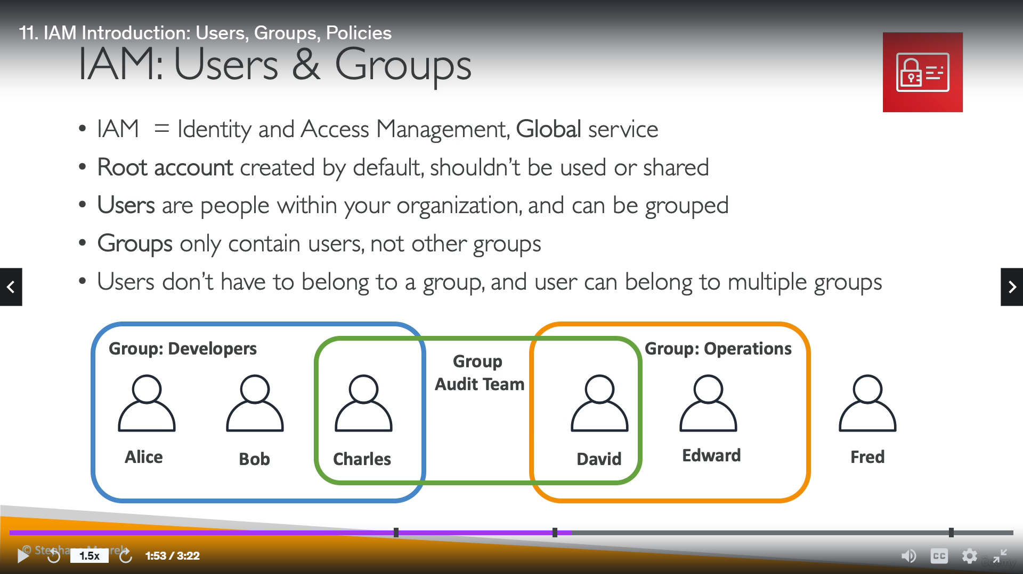
IAM: Users & Groups

Slide 8
IAM: Permissions
Users or groups can be assigned JSON documents called policies.
These policies define the permissions of the users.
In AWS you apply the least privilege principle: don't give more permissions than a user needs

Slide 9
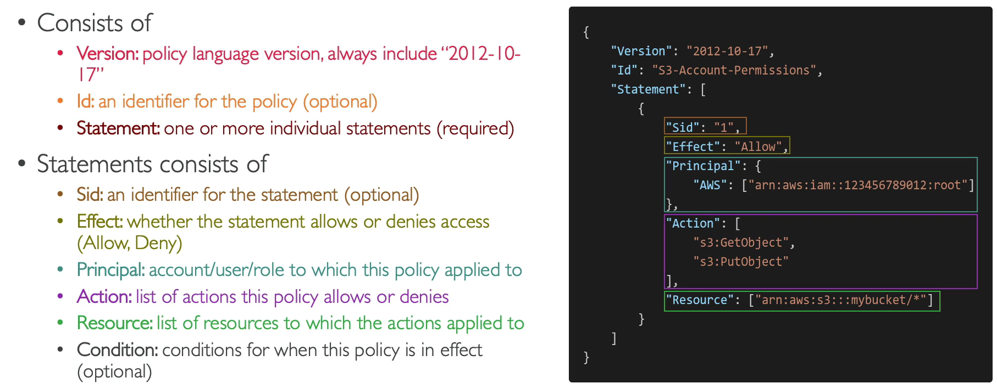
IAM Policies Structure

Slide 10
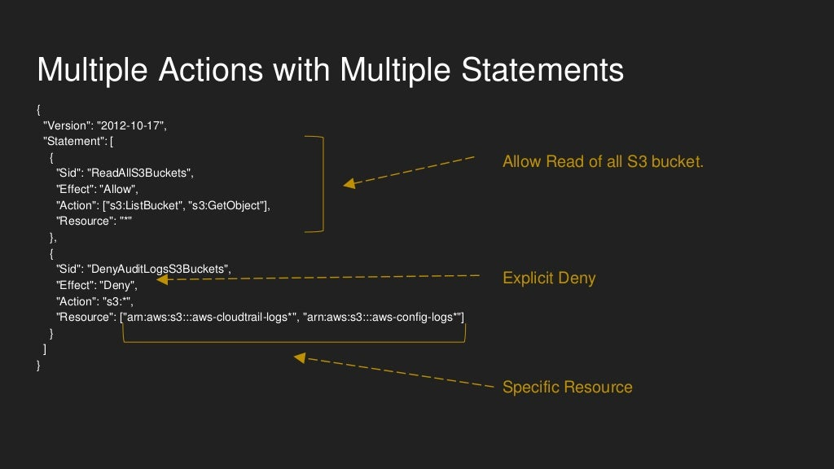

Slide 11
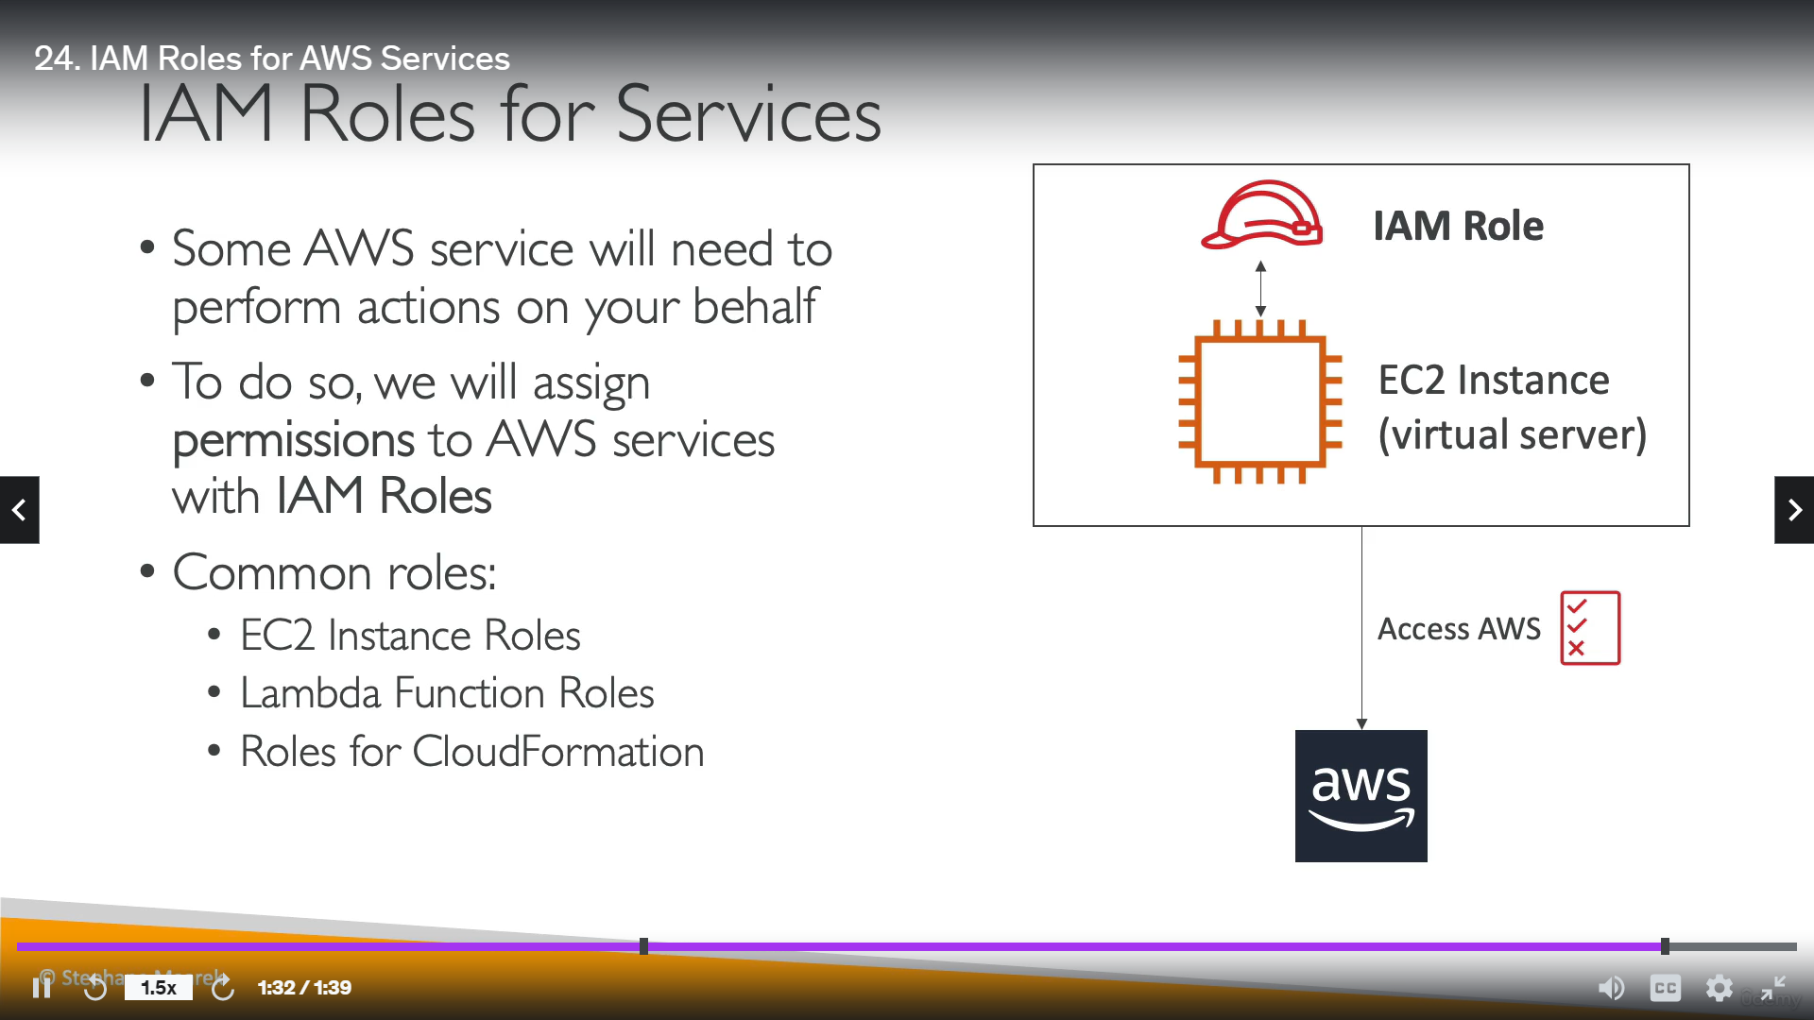
IAM: Roles for Services
Some AWS services will need to perform actions on your behalf
To do so, we will assign Permissions to AWS services with IAM Roles
Common roles:
EC2 instance Role
Lambda Function Role
Roles for CloudFormation

Slide 12
IAM: Security Tools
IAM credentials Report (account-level)
A report that lists all your account’s users and the status of their various credentials
IAM Access Advisor (user-level)
Access advisor shows the service permissions granted to a user and when those services were last accessed.
You can use this information to revise your policies.

Slide 13
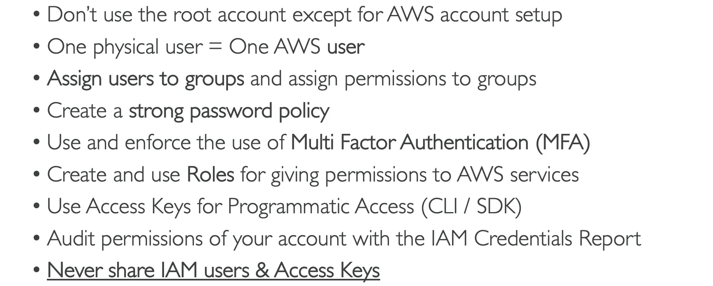
IAM: Guidelines & Best Practices

Slide 14


